Slide 1


RELIEF
Disaster Insurance System
Presentation by Ratna Jashwanth

Slide 2
Problem Statement
Traditional disaster insurance processes are slow, fragmented, and lack transparency, especially during large-scale emergencies.
Disconnected Workflows
No Transparency
Manual Processes
Policy issuance, claims, underwriting, and finance operate in separate systems with communication gaps.
Customers lack visibility into claim status or who's processing their case.
Spreadsheets and emails increase errors, delays, and fraud risk.
Poor Coordination
Weak Monitoring
Agents lack visibility into claims progress, hindering customer assistance.
Manual tracking makes real-time risk pool assessment impossible.

Slide 3






Relief Platform: Disaster Insurance
An operational backbone for disaster insurance management with structured, role-based workflows.
Role-Based Workflow
Structured Policy Process
Dedicated roles for customers, agents, claims officers, and administrators with clear actions.
Automatic linking to disaster zones and risk categories.
Data-Driven Premiums
Streamlined Underwriting
Risk insights enable informed recommendations instead of guesswork.
Direct routing eliminates manual communication and document loss.
Real-Time Monitoring
Financial Traceability
Automatic risk pool updates with financial exposure tracking.
Every transaction linked to policy, claim, and disaster risk pool.

Slide 4
Tech Stack — Relief Insurance Platform
🖥️ Frontend
⚙️ Backend
Category
Technology
Category
Technology
Framework
Angular
Framework
Spring Boot
Language
TypeScript
Language
Java
Styling
Tailwind CSS
Security
Spring Security
Routing
Angular Router (Lazy Loading)
JWT Library
jjwt (io.jsonwebtoken)
State Management
Signals
ORM
Spring Data JPA + Hibernate
Auth (Token Decode)
jwt-decode
Database
H2 (In-Memory)
Build Tool
Maven

Slide 5
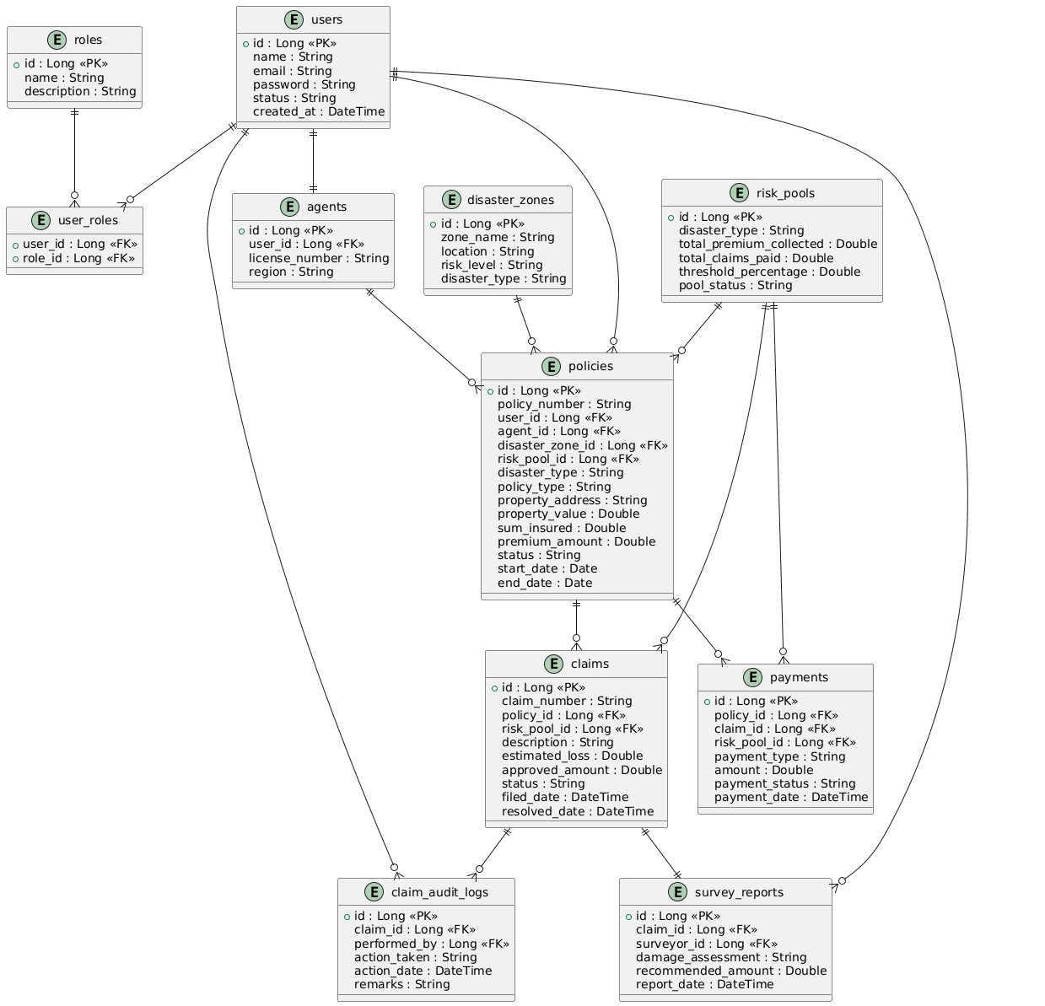
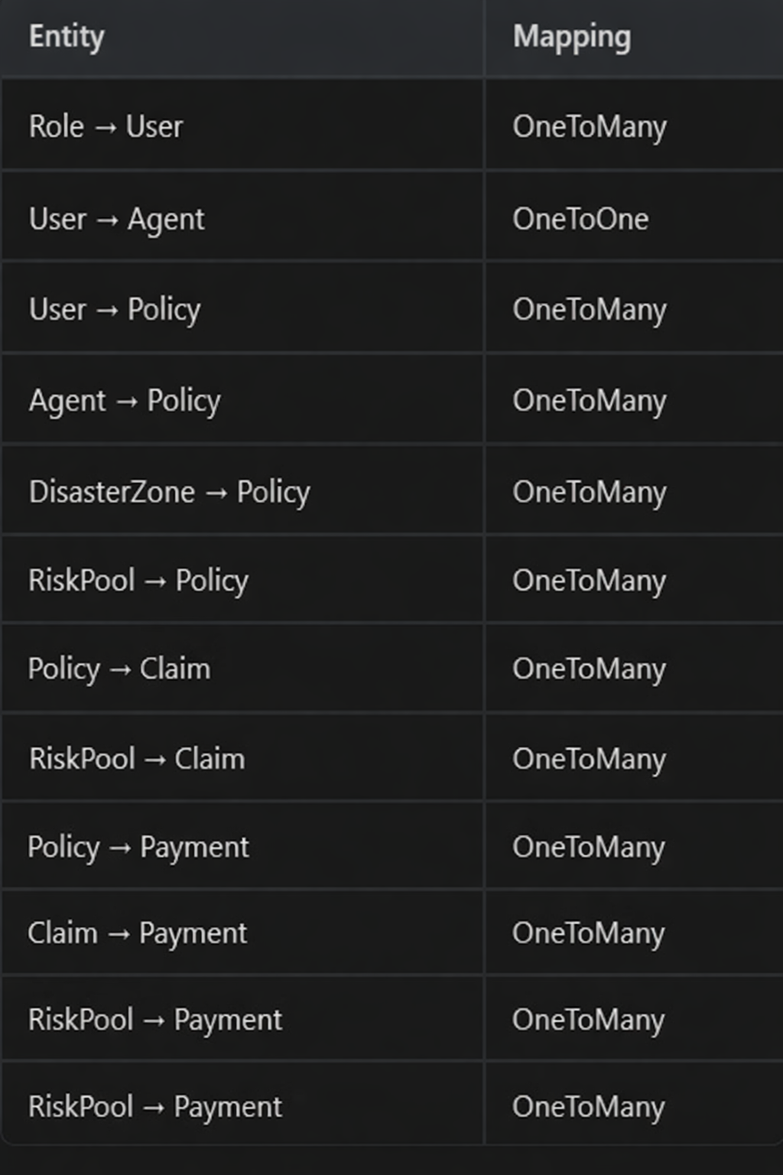
ER DIAGRAM

Slide 6
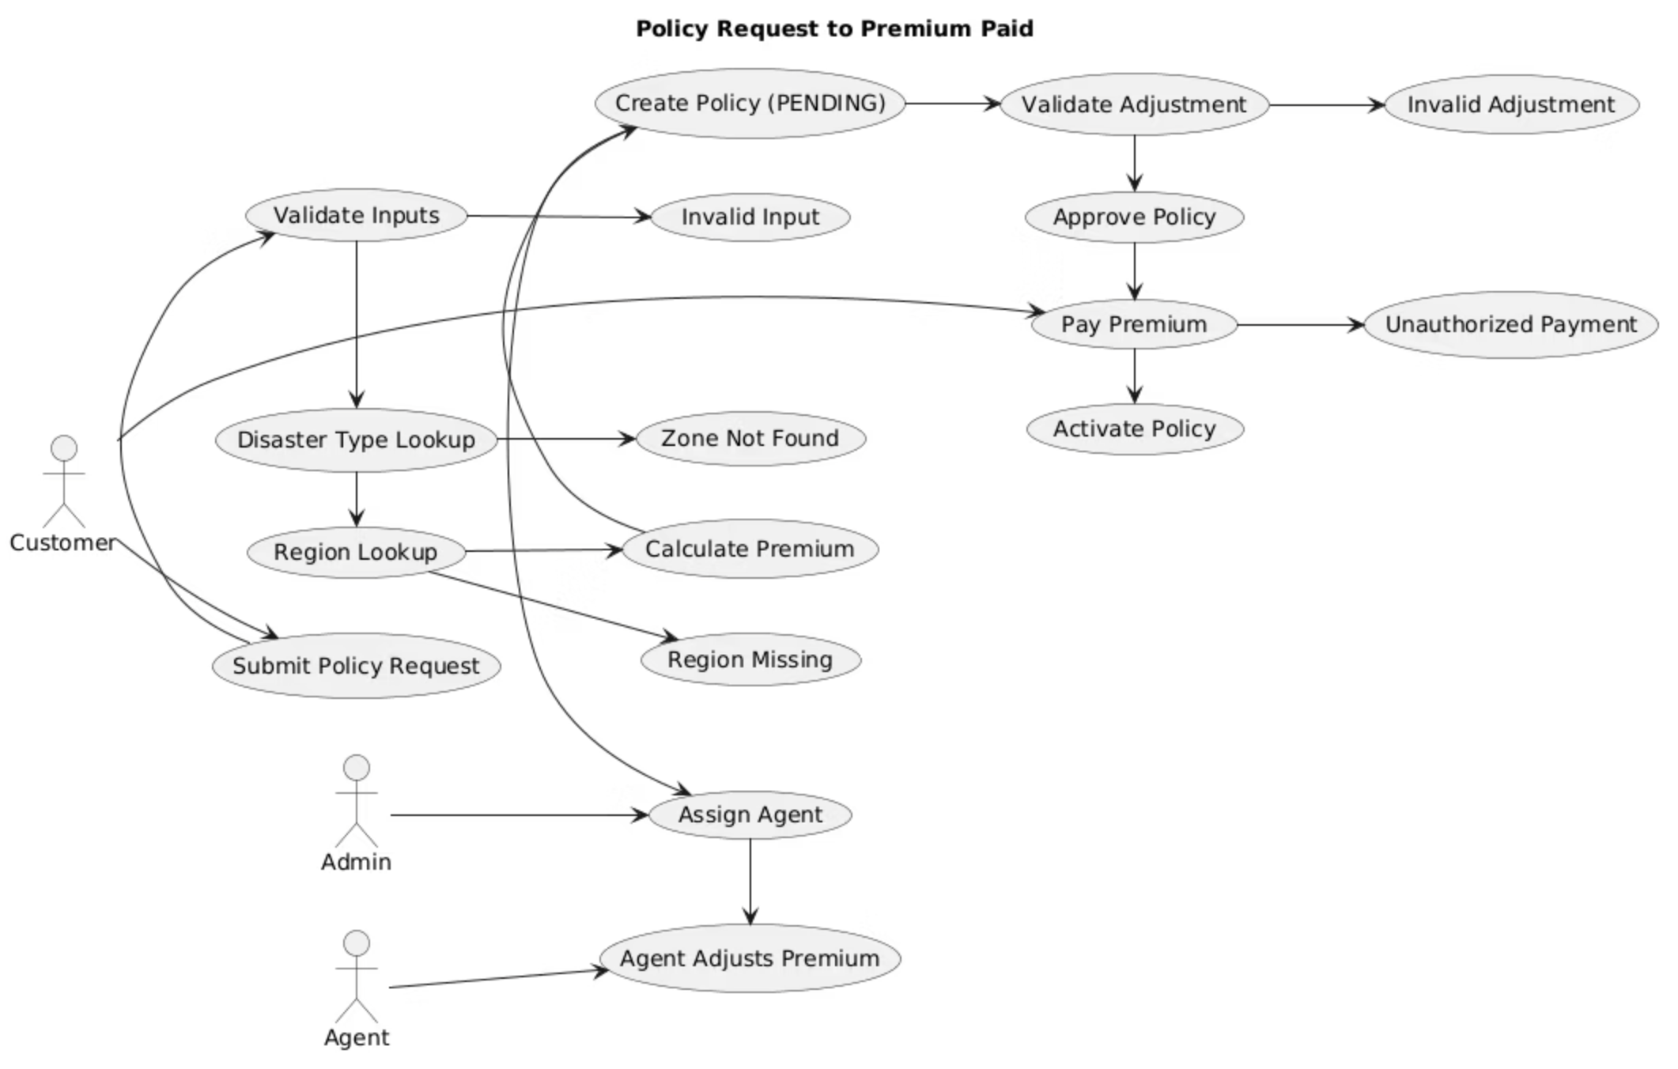
Policy Request to Premium Paid Workflow
The workflow illustrates the end-to-end process from initial request to the final premium payment, ensuring transparency and efficiency at every stage.

Slide 7
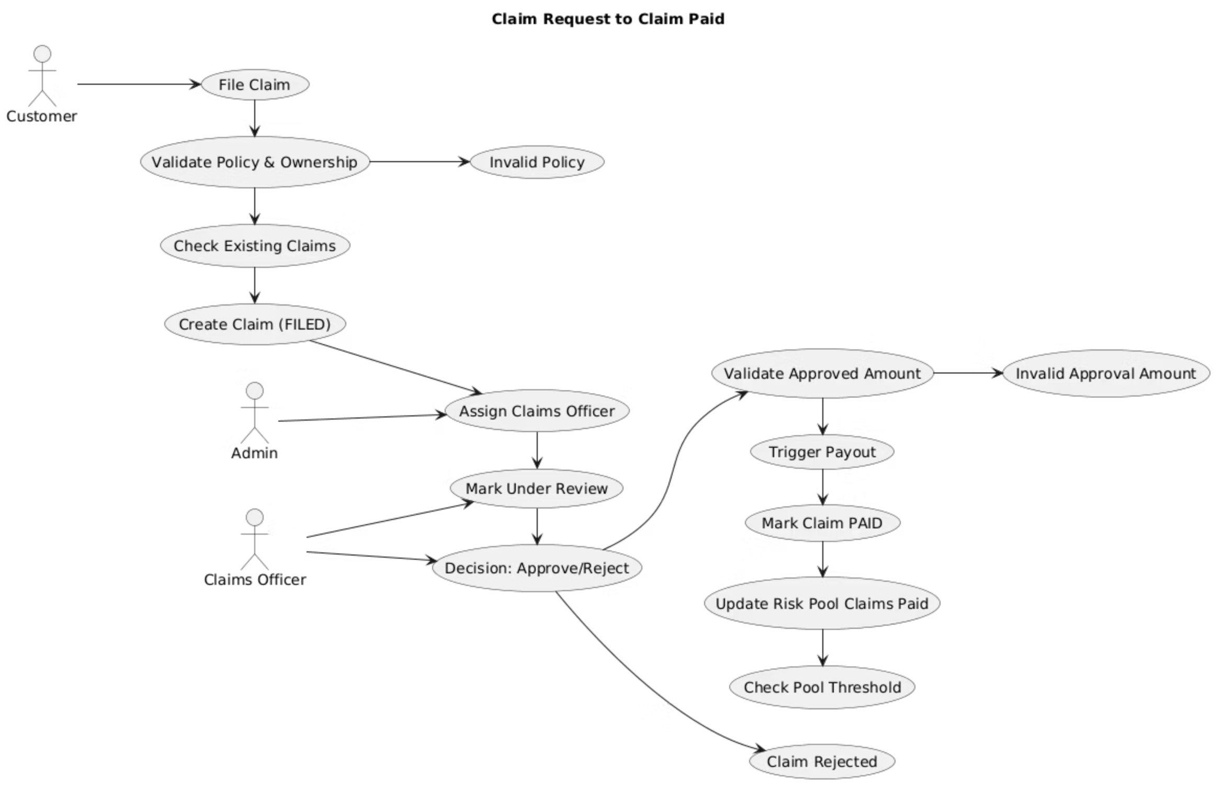
Claim Request to Claim Paid Workflow
This workflow outlines the end-to-end process from the initial claim request through to the final claim payment, designed to ensure clarity, compliance, and operational efficiency throughout the entire cycle.

Slide 8
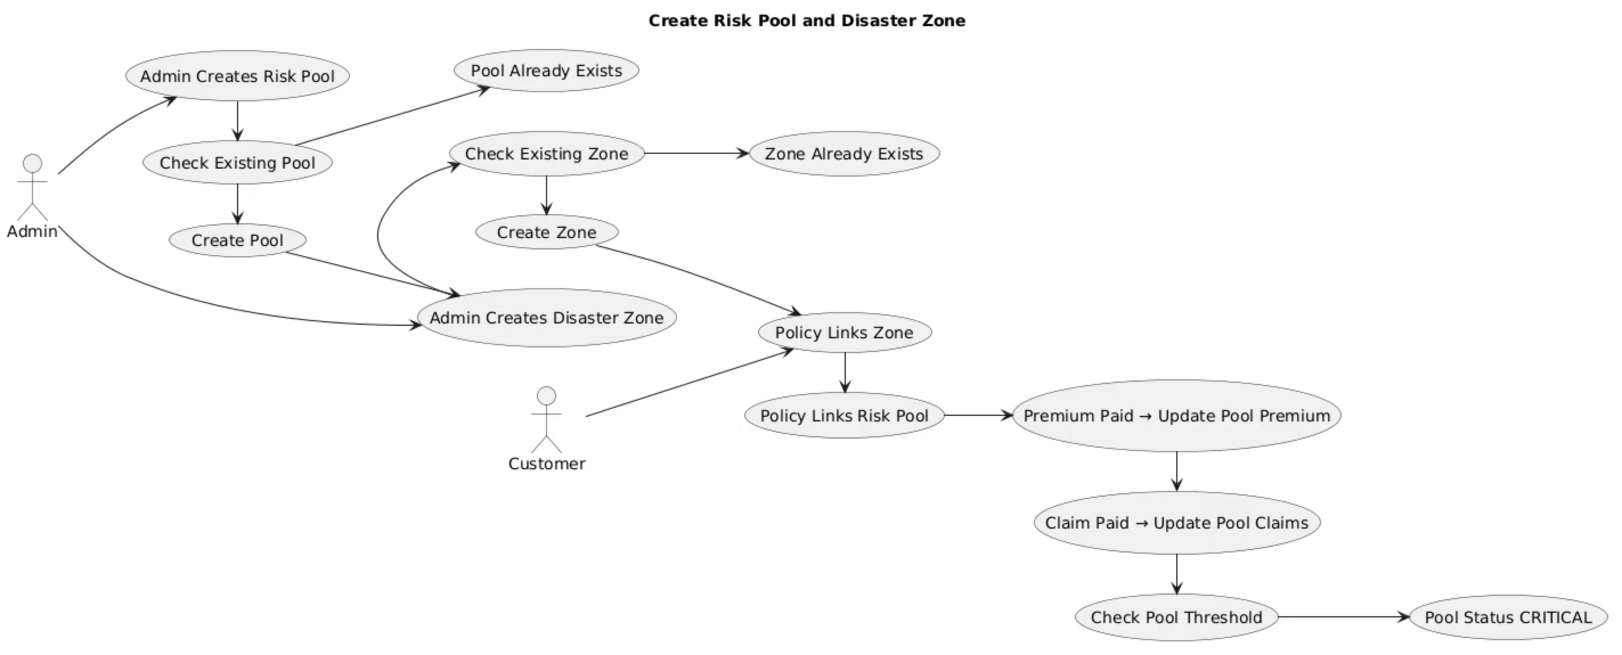
Create Risk Pool and Disaster Zone Workflow
This workflow details the comprehensive process for defining and managing risk pools and disaster zones within the Relief Platform. This structured approach allows for precise policy linking, real-time risk exposure monitoring, and dynamic adjustment of premiums, forming the foundation for resilient disaster insurance operations.

Slide 9




Future Scope
Real-time notifications
In-app chat/support
Document upload and OCR
Integration with payment gateways
Send alerts for claim status, policy updates, and disaster events.
Enable live chat between customers, agents, and support staff.
Allow users to upload documents and extract data automatically.
Support online premium payments and claim disbursements.

Slide 10
THANK YOU !!!

